Slide 1
Power BI – Importing Data And Overview
A Beginner’s Guide to Getting Started with Power BI.
By NIVED SUDHINDRAN

Slide 2
Introduction to Power BI
What is Power BI?
A business analytics service by Microsoft.
Enables users to visualize data and share insights.
Key Features:
Interactive reports
Data visualization
Integration with various data sources

Slide 3
Importance of Data Importing
Why Import Data?
Data is the foundation of analysis and reporting.
Enables users to visualize data and share Proper data importing leads to accurate insights.
Types of Data Sources:
Files (Excel, CSV, etc.)
Databases (SQL Server, Oracle, etc.)
Online services (Azure, Salesforce, etc.)

Slide 4
Importing Data: Step-by-Step
Open Power BI Desktop.
Click on 'Get Data' from the Home tab.
Choose the Data Source:
Excel, CSV, Web, Database, etc.
Load Dat
Preview the data.
Click 'Load' or 'Transform Data' for cleaning.

Slide 5
Importing Data: Step-by-Step
Open Power BI Desktop.
Click on 'Get Data' from the Home tab.
Choose the Data Source:
Excel, CSV, Web, Database, etc.
Load Dat
Preview the data.
Click 'Load' or 'Transform Data' for cleaning.

Slide 6
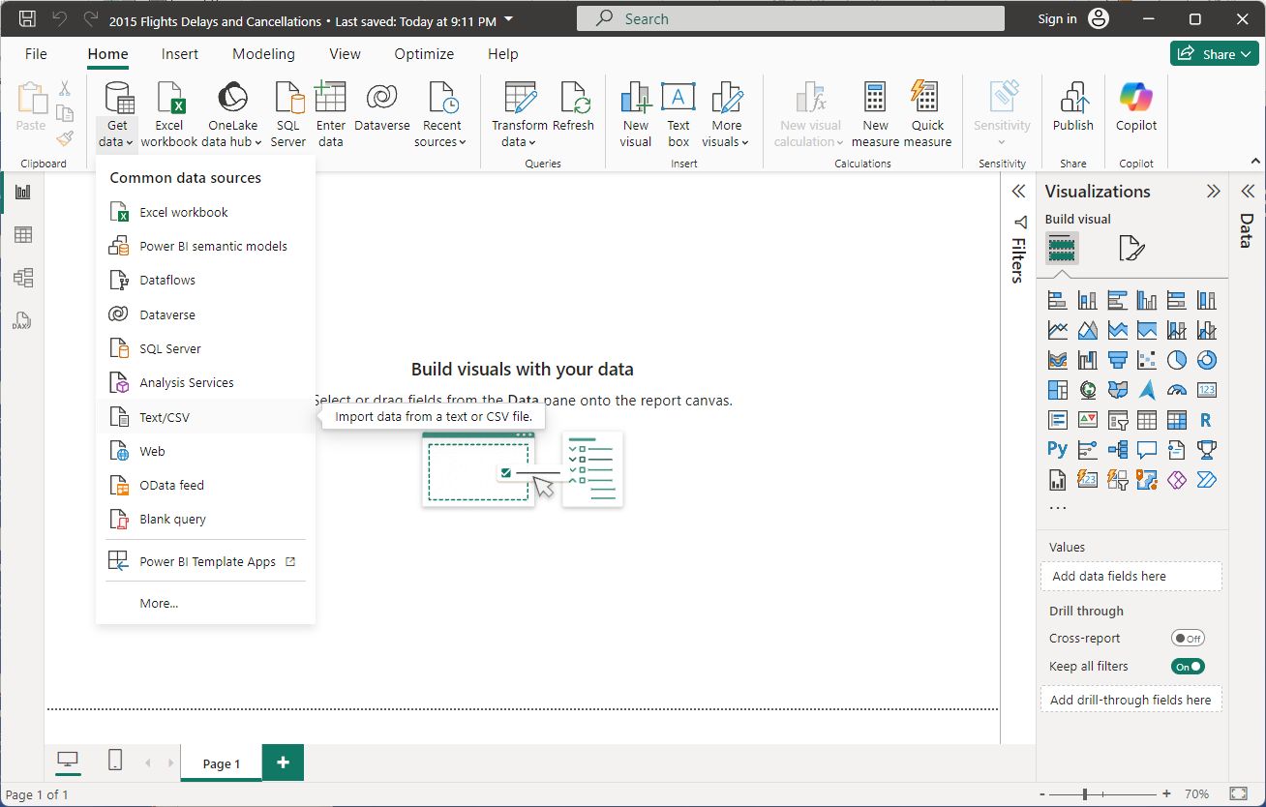

Slide 7
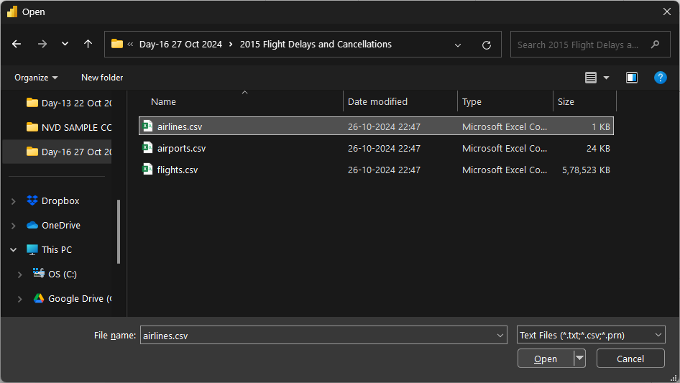
Select the CSV File one at a time, and click Open.
Perform the same steps for the airports.csv and flights.csv files.

Slide 8
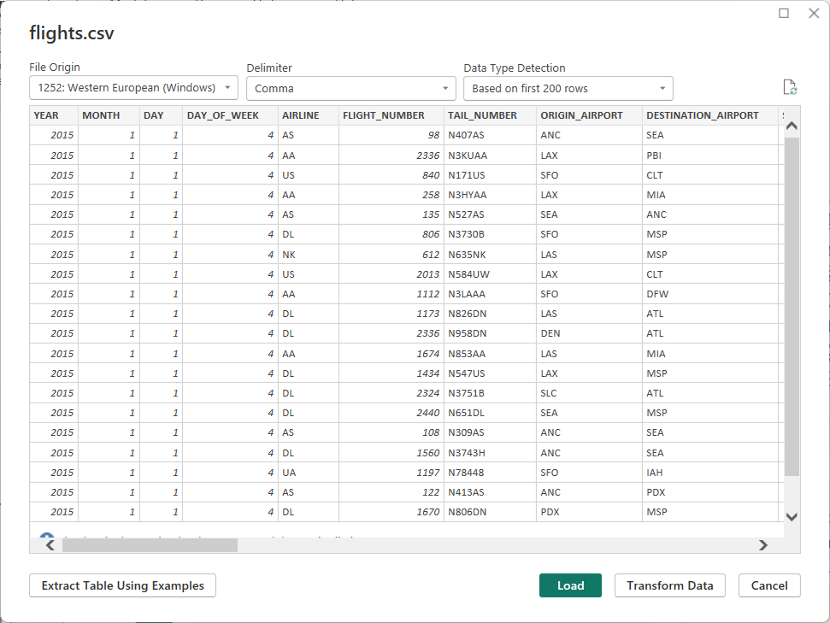
Click on LOAD button.
This might take a few minutes according to the size of your file.

Slide 9
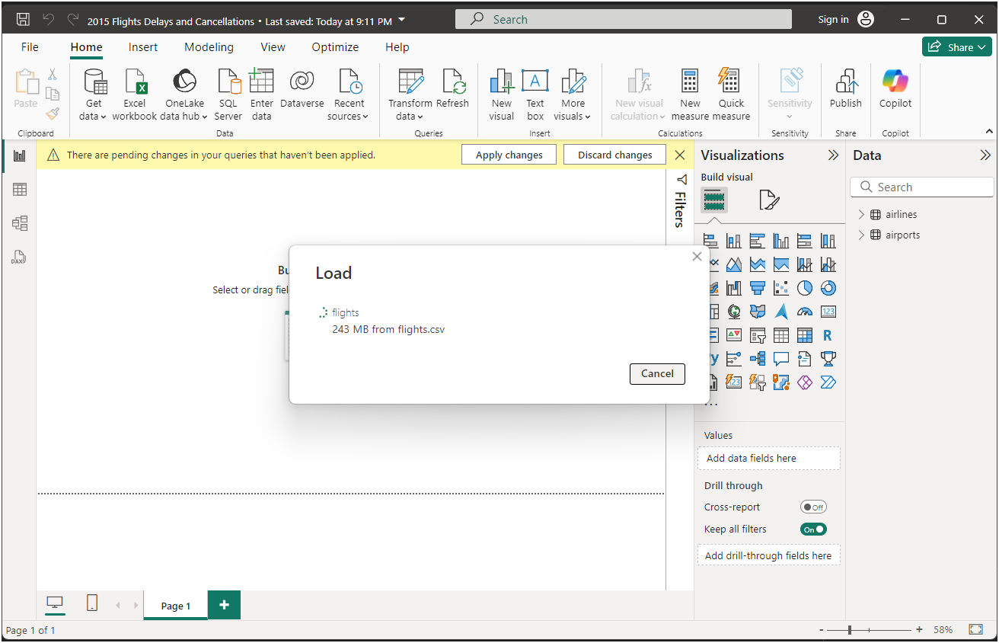

Slide 10
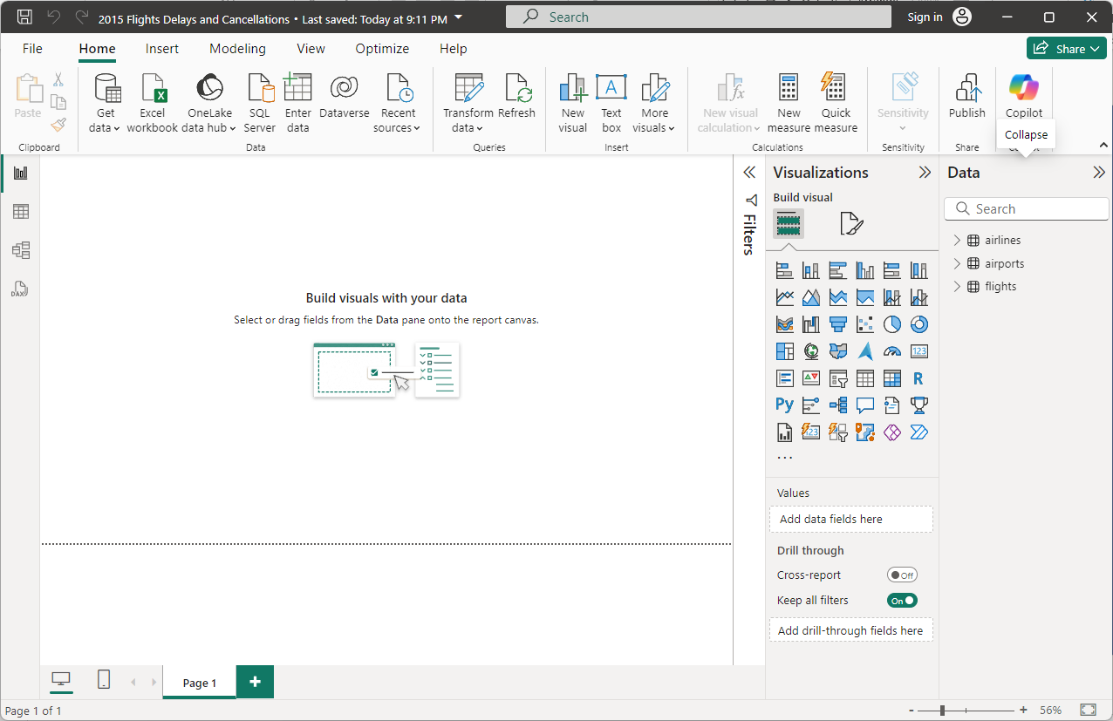
Once completed loading all the files, all tables will be visible in right side DATA area

Slide 11
Now we have successfully loaded the data into our Power BI Desktop.
We will be looking into how we can handle duplicate and missing data in the next session.
THANK YOU….

